Slide 1






Harnessing Solid State Detector Technology in Inductively Coupled Plasma to Determine Unknown Elements in a Lubricant Sample
Steve Twining
PerkinElmer, Inc.
https://stle.webex.com/stle/j.php?MTID=m76ae73926a3495b30ddff569f76f4e40

Slide 2
ICP and lubricants
Detector Technology History
Running Unknowns in Lubricant Samples
Elemental Fingerprint
Summary

Slide 3
ICP Lubricant Analysis
In-Service Oils
Wear Metals
  Fe, Cr, Mo, Al, Cu, Pb, Sn, Ni, Ag, Sb, Tl, Cd
Ingress Metals
  Si, Na,
Additive Metals
  Ca, Mg, Zn, P, Mo, B

Slide 4
ASTM Methods
ASTM D-5185: “Standard Test Method for Multielement Determination of Used and Unused Lubricating Oils and Base Oils by Inductively Coupled Plasma Atomic Emission Spectrometry “
ASTM D-4984: “Standard Test Method for Determination of Additive Elements in Lubricating Oils by Inductively Coupled Plasma Atomic Emission Spectrometry”

Slide 5
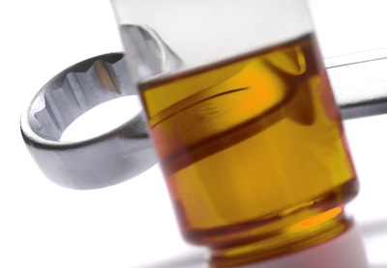
Unknown Sample
Whutizzit??

Slide 6
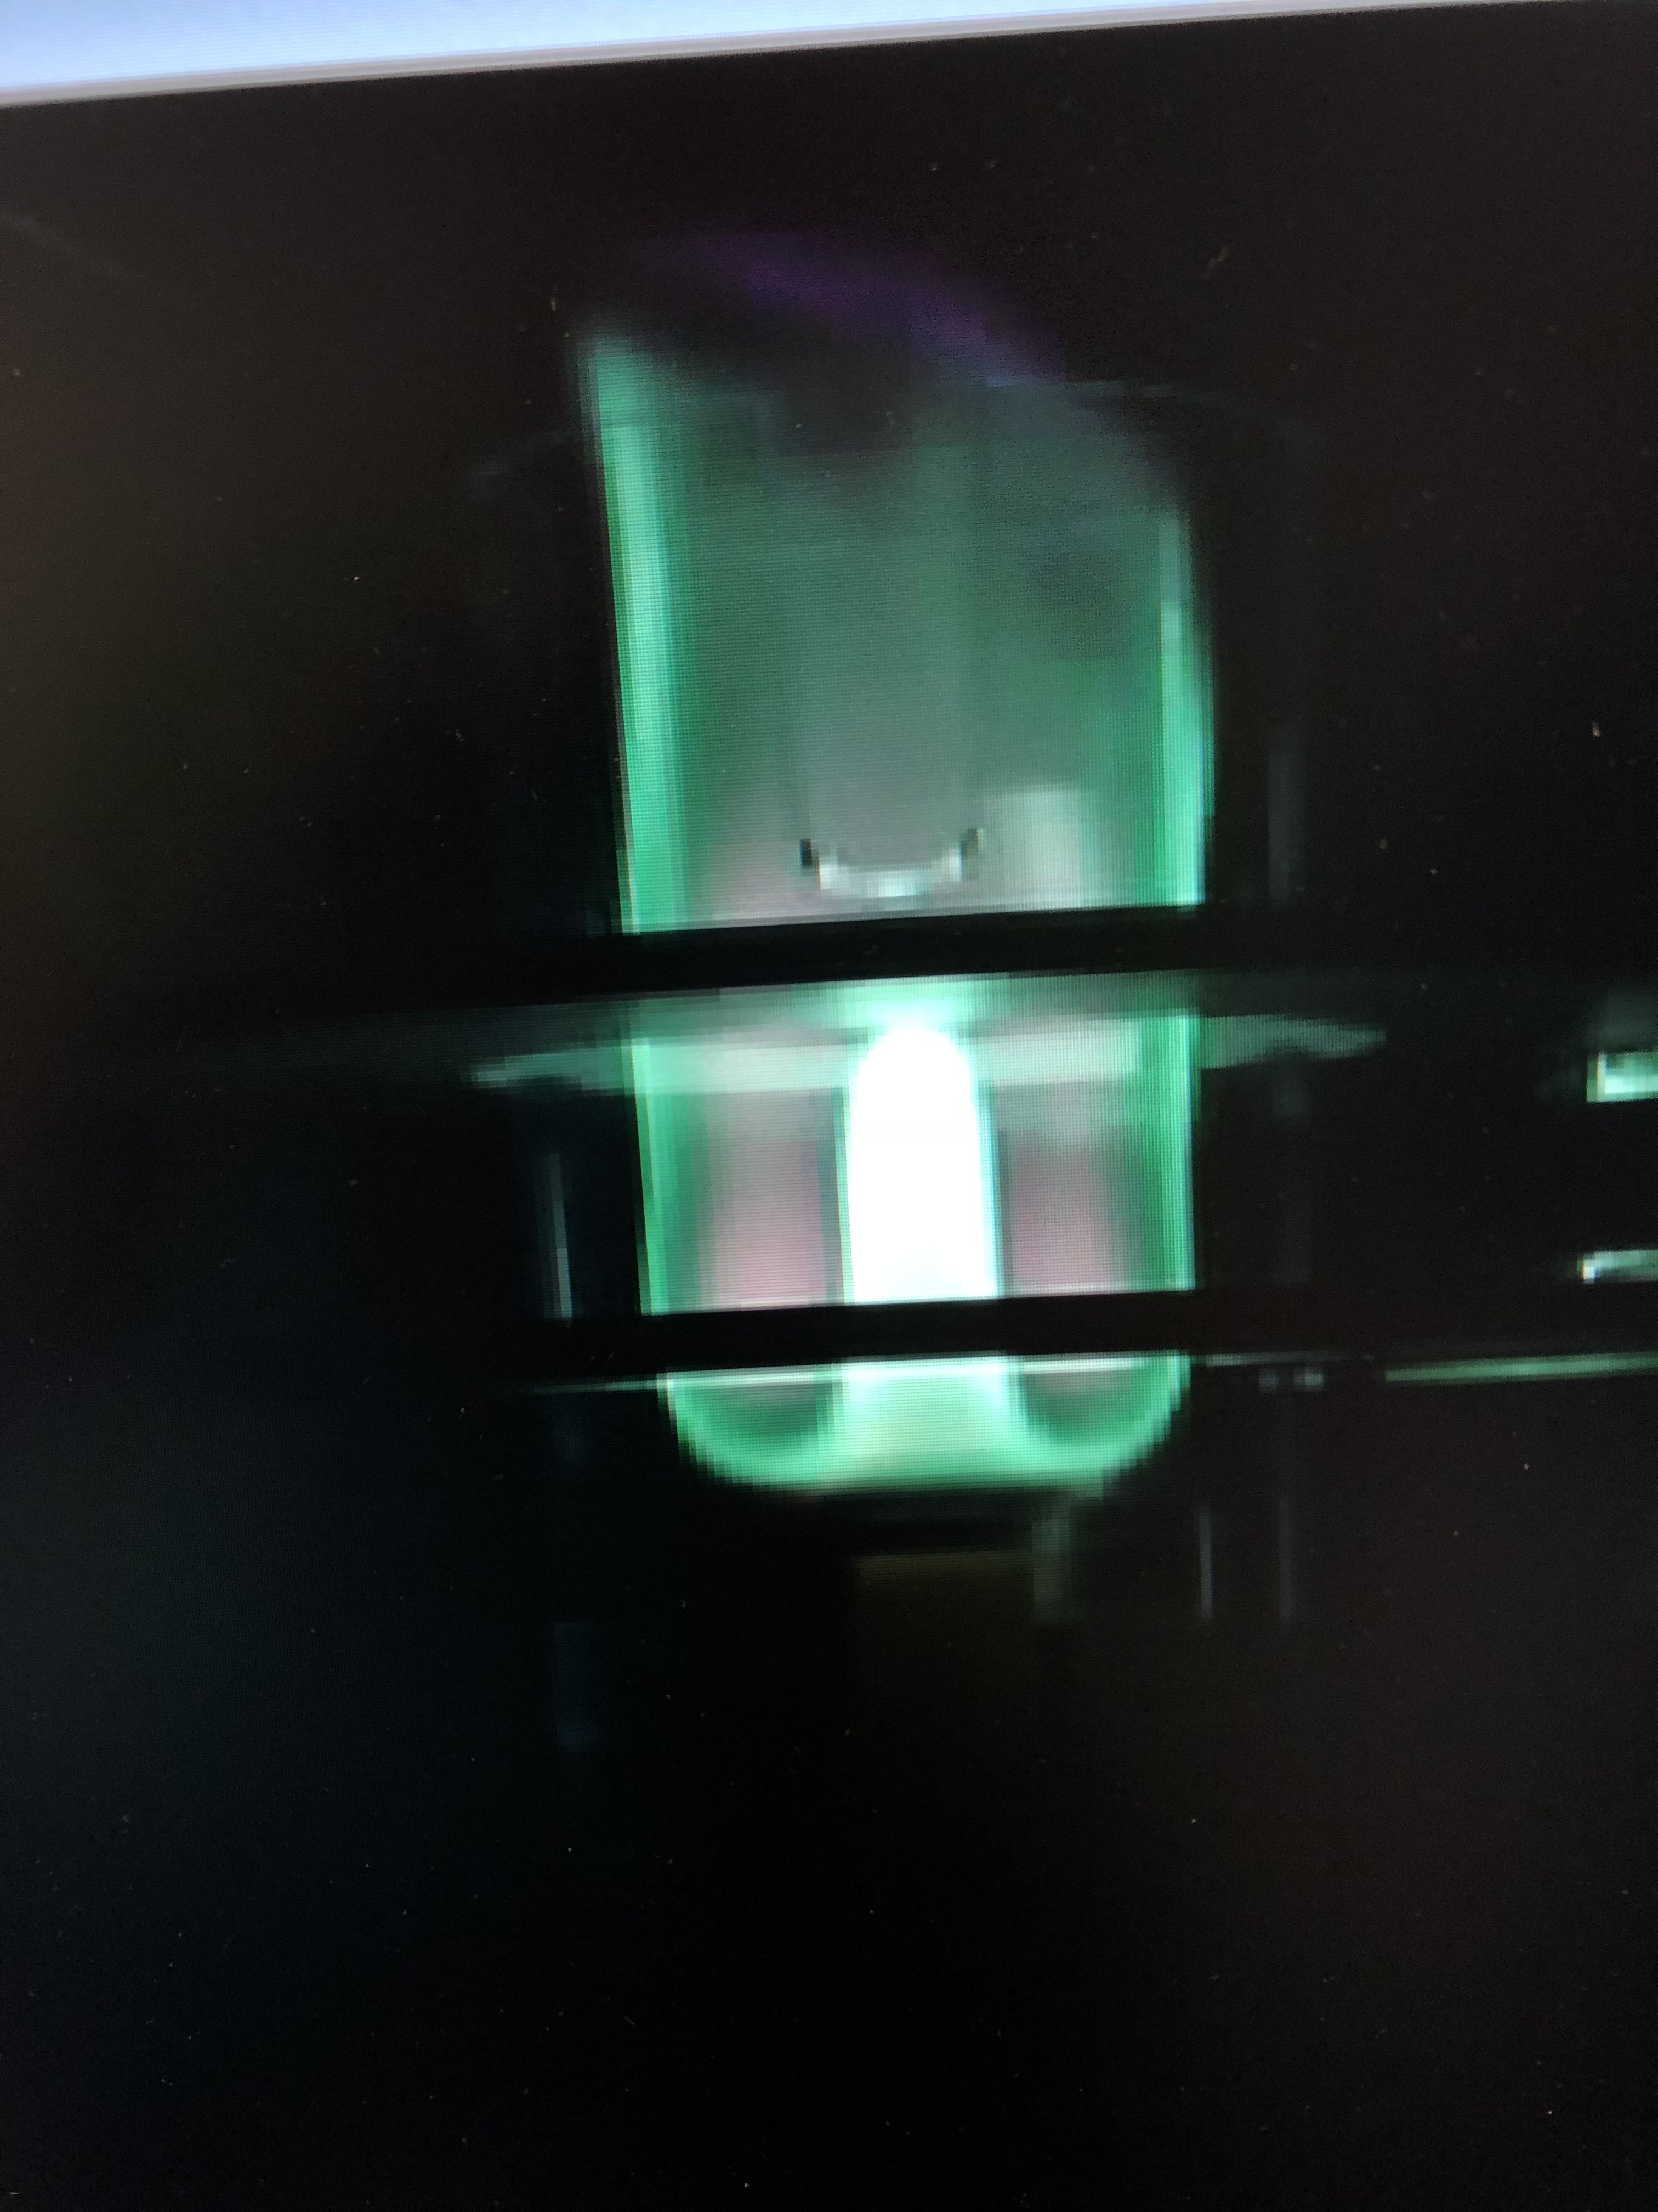
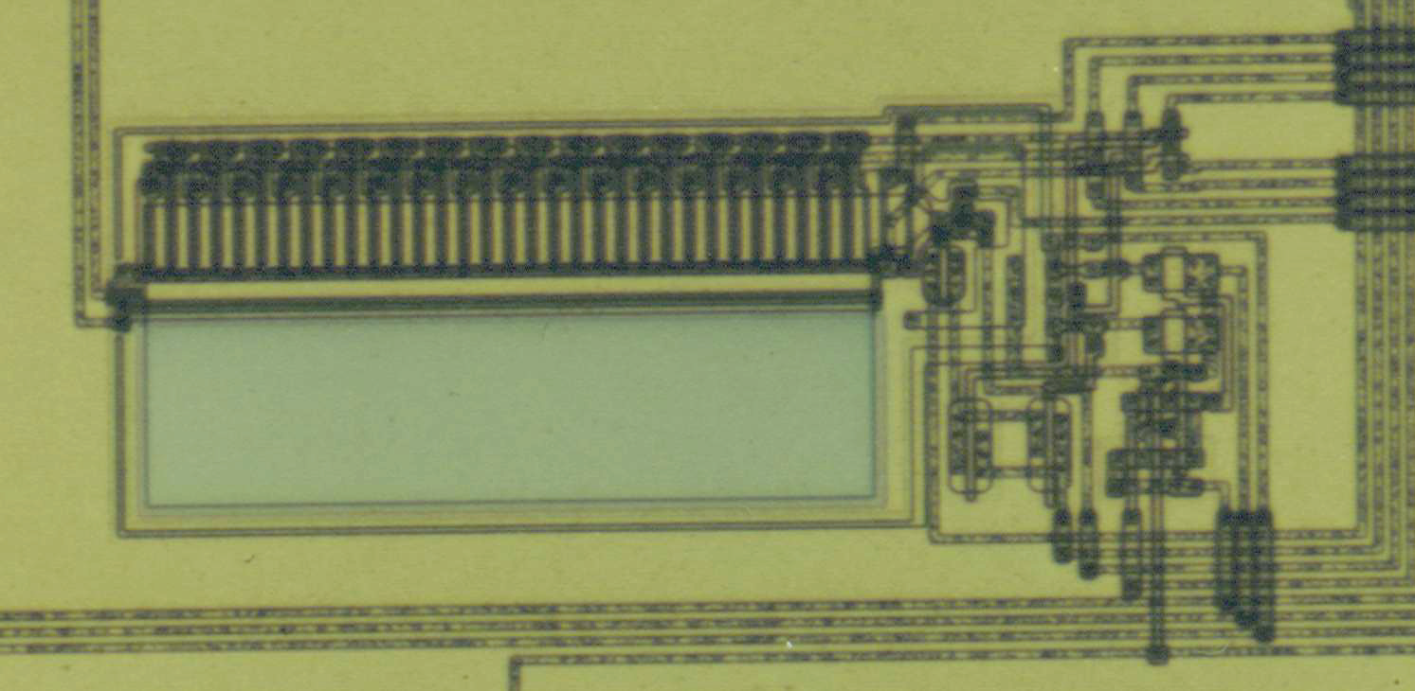
ICP Overview
ICP
Plasma
Spectrometer
Segment
Detector

Slide 7
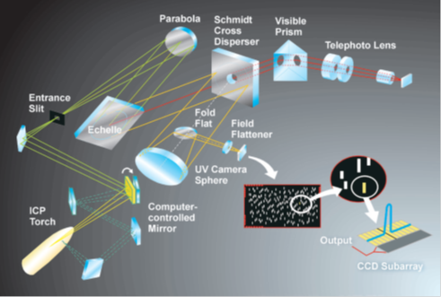

Photons are the name of the game

Slide 8
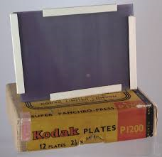
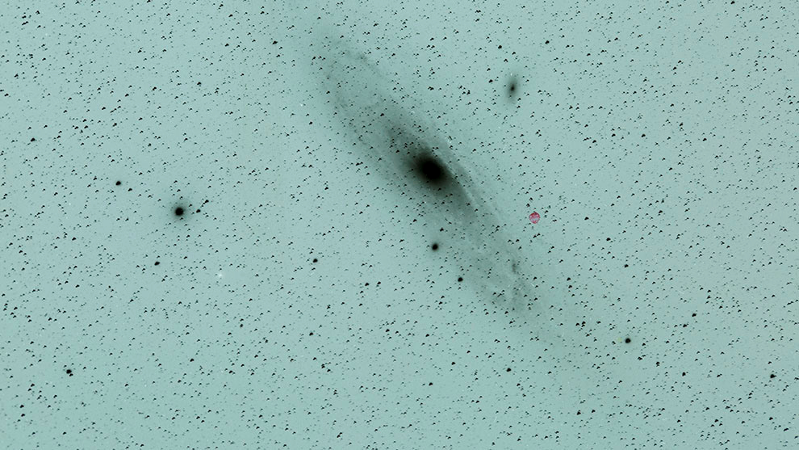
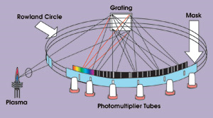
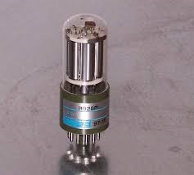
Detectors
Photographic Plates
Photomultiplier Tubes

Slide 9
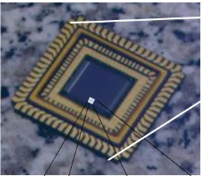


1980’s-1990’s

Slide 10

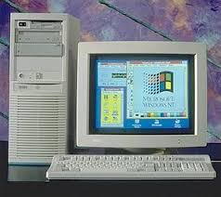
One Problem….
Processor Speed =

Slide 11



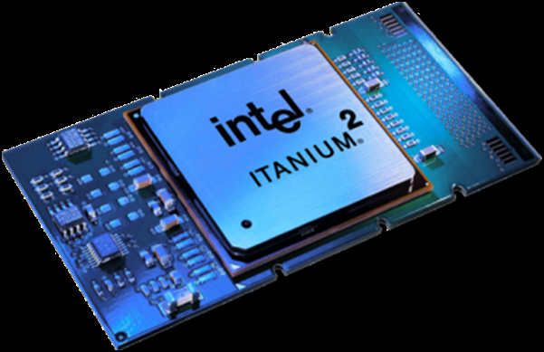
Fast Forward…..

Slide 12
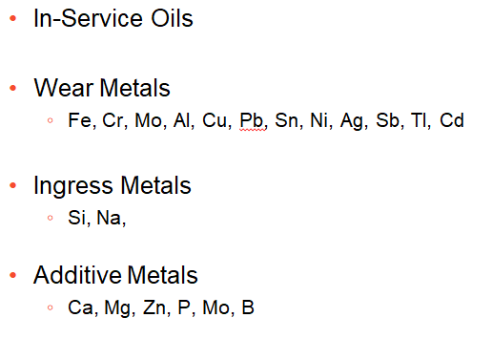
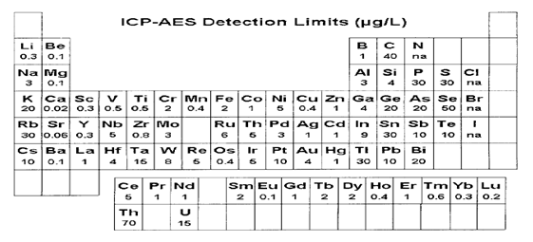
~73 Elements. Simultaneously. Multiple Wavelengths

Slide 13
Unknown Sample
Whutizzit??

Slide 14

Multiple Wavelengths

Slide 15
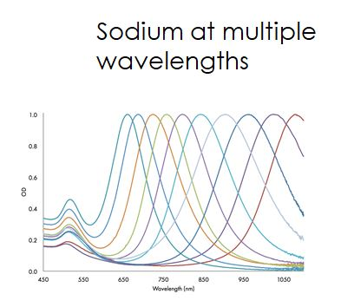

Multiple Wavelengths in ICP
Confirmation

Slide 16
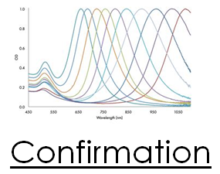


Putting the picture together
Qualitative = what’s in it

Slide 17
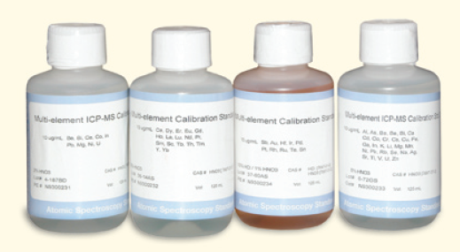

What about Quantitative?
Known Standards
Unknown Sample
Uber Semi-Quantitative= about how much

Slide 18
